Slide 1
Why Taiwan’s Education Matters : When Globalization Meets Localization

Slide 2
Chuing Prudence Chou (周祝瑛) National Chengchi University (NCCU), Taiwan Fulbright Scholar CIEP, 20th Anniversary of the Revue internationale d’éducation de Sèvres Paris, France, 17th, 06, 2014

Slide 3
Outline
1. Historical context and Country Profile
2. Reasons Why Taiwan’s Education Matters?
---- the Global Context
-----the Global Context
3. Impacts and Challenges
.
.

Slide 4
Historical context and Country Profile

Slide 5
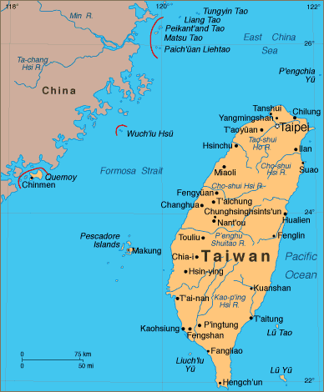

Slide 6
TAIWAN (Republic of China, Formosa)
13,969 square miles
pop: 2.3 million
Four Asian Tigers
35% of GDP in 1952
Less than 4% in 2014

Slide 7
Illiterate Rate :15 and above
1952 (42.1%, Japanese)
·
1994 (5.8%, in Mandarin)
2004 (3.03%)
Japanese Colony (1895-1945): Language transition policy, Chinese –only policy

Slide 8
Educational philosophy
Confucian Heritage:
-- political authoritarianism, group-oriented human network, academic-driven, respect for teachers and the elderly
-- Exam orientation (694–1895): A system used as a tool for social control by the ruling class to select intellectuals for the governing class through public examinations

Slide 9
Reasons Why Taiwan’s Education Matters?
---- from the Global Context

Slide 10
PISA and TIMSS
PISA Taiwan 2012
Math 4th
Reading 7th
Science 13rd
TIMSS Taiwan 2011
8th grade Math 3rd, 4th grade 4th,
8th grade Science 2nd, 4th grade 6th
Slightly declined since 2007

Slide 11
International Mathematical Olympiad
ALWAYS HAVE Good records
But DISCRAPANCY BETWEEN STUDENTS BASED ON REGION, SCHOOL DISTRICT, AND FAMILY SES CONTINUES TO GROW

Slide 12
ICT Coverage Rate and Education
63.80% of Taiwanese are frequent uses of internet in 2013.
100 % of schools and governments have internet access.
All the 24-hour chain stores have Wi Fi access nation-wide
Within top 10 in the world according to WEF/NRI Ranking agencies

Slide 13
Over-use of Smart phone and internet: addiction issue
Bullying and cyber bullying
Psychological risk factors of addiction to social networking sites
Recent Stressful Life Events, Personality Traits, Perceived Family Functioning and Internet Addiction among College Students

Slide 14
The internet-native generation
University students demonstration and occupation of the congress and administrative offices for more than three weeks in Taiwan, March, 2014
The Taipei Metro Massacre on 21st May, 2014
https://www.youtube.com/watch?v=kYt3maQQu-c

Slide 15
Reasons Why Taiwan’s Education Matters?
---- from the Local Context

Slide 16
Education System
6-3-3-4 (1922 adopted from the US in China)
Compulsory education has covered the first nine years since 1968 and will expand to 12 years in Sep. 2014 (the first one in Asia)

Slide 17
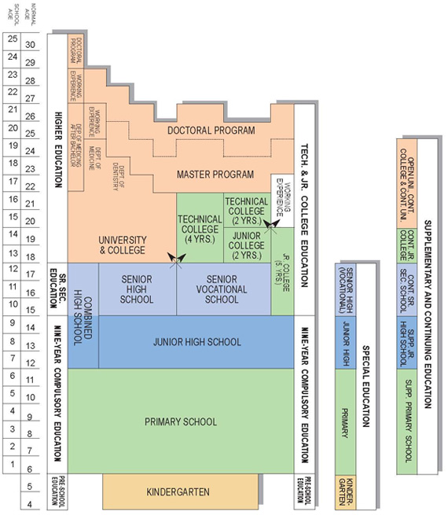

Slide 18
Confucius Heritage
Compulsory education has covered the first nine years since 1968 when China was still undergoing the Cultural Revolution (1966-76)
Cultural and educational continuity

Slide 19
A Credential Society
Influence of the examination tradition:
Hard work via drills and practice
Respect teachers
High parental expectations and investment in education:
Effort over Innate Abilities
18% of total family income
(2nd highest in Asia)
71.7% of college students depend on family financial support

Slide 20
High Priority in Education from Public and Privte Sector
Have launched a series of Education Reform Programs since 1994 and resulted in mixed impacts.

Slide 21
Will expand to 12-year Basic Education in Sep. 2014 (the first country in Asia)
Education and culture account 4.3 % of Taiwan’s GDP in 2005 (5 % in OECD)

Slide 22
Parents pay about NT$2,640 (US$80) per subject per month for cram schools.
NT$7,920 (US$240) in total per month every household of children in Taiwan

Slide 23
Higher Educational Expansion since late 1990s.
70 % of 18-22 age cohort attend higher education, the second highest in Asia (next to Korea).

Slide 24
Year | Low-income families (Lowest 20%) | High-income families (Highest 20%)
1976 | 4.4 | 29.4
1981 | 7.3 | 28.0
1986 | 13.4 | 30.8
1991 | 23.0 | 36.7
1996 | 30.8 | 48.2
2000 | 37.1 | 59.2
2001 | 39.9 | 64.4
2002 | 36.9 | 67.4
2003 | 45.0 | 69.2
2004 | 45.7 | 73.7

Slide 25
Birth Decline and Aging Society
Since late-1990s
Birth rate reached 1.07 and has declined ½ over the last 20 years.
Consequences in Education:
----On going school closure and merging
----Upcoming University Closure
----Shrinking Workforce

Slide 26
A long school day
To achieve a higher score on their senior high school or university entrance exams at the end of 9th and 12th grade, students tend to stay in school till as late as 8 or 9 pm for "extra classes."
Students spend a large amount of time in schools, typically from early childhood to their early twenties.

Slide 27
A SCHOOL DAY(10th Grade)
Class period | Mon | Tue | Wed | Thu | Fri
7:10–7:20 | Clean campus
7:20–7:50 | Morning homeroom
7:50∼8:10 | Morning meeting
8:10–8:55 | Chinese | Science | English | Geo. | Chinese
9:10–9:55 | Chinese | Chinese | Science | Chinese | Art Performance
10:10–10:55 | Science | English | Math | English | Math
11:05–11:50 | Math | Health & P.E. | Integrated & Activities | Math | Art
11:50–12:30 | Lunch break

Slide 28
12:30∼13:10 | Nap time
13:20–14:05 | School meeting | Civics | Chinese reading | History | English conversation
14:15–15:00 | Class meeting | I & A | Music | English composition | Science
15:00–15:25 | Clean campus
15:25–16:10 | Clubs | I & A | Health and P.E. | English composition | Health & P.E.
16:20–17:05 | English | Math | Chinese | Science | English reading

Slide 29
Peace-building via student exchange very positive effect on Chinese exchange students

Slide 30
The Taiwan Cross-strait relationship has been highly politicized since 1949 when KMT government withdrew from China to Taiwan.
But the educational exchange has made a huge progress since 1990s.

Slide 31
More than thirty- thousand Taiwanese students have studied in Chinese higher education since 1980s.
More than twenty- thousand Chinese students have studied in Taiwan’s higher education since mid-1990s.

Slide 32
Impact and Challenges

Slide 33
Visible and Invisible
The overshadow of China
Exclusion from UN, UNESCO, and many more… in terms of educational collaboration, exchanges and provision of educational statistics and data
A Fair game for all members in the global community

Slide 34
Conclusion: Why Taiwan’s Education Matters?
1. Shared same agenda with the world:
--- Declining birth rate, aging society, internet impact on education
Value of academic achievement (PISA), 12-year educ expansion (first in Asia), Educ contributes to Economic success (four tigers)
Experiment Hub for Chinese education (curriculum reform per se) but overshadow by China in the international community

Slide 35
Questions and Comments
Chou’s email: iaezcpc2007@gmail.com
Website: http://www3.nccu.edu.tw/~iaezcpc/renew_j_index.html
Books:
Taiwan Education at the Crossroad (2012).
The SSCI Syndrome in Higher Education (2014)

Slide 36

Merci beaucoup

